Slide 1
DEPARTMENT OF CSE &CSIT
COURSE NAME – ADAPTIVE Software Engineering
COURSE CODE – 23CI2001
Topic:
KANBAN

Slide 2



AIM OF THE SESSION
To familiarize students with the basic concept of requirements documentations i.e. SRS and User stories
INSTRUCTIONAL OBJECTIVES
This Session is designed to:
Demonstrate Kanban methodology of agile development
Describe explain the principles of Kanban
List out the Benefits of Kanban
Describe the How Kanban can be used?
LEARNING OUTCOMES
At the end of this session, you should be able to:
Define Kanban methodology and its principles
Describe Importance of Kanban methodology
Summarize Kanban and its benefits.

Slide 3
SELF-ASSESSMENT QUESTIONS
Life cycle of Kanban process?
When the Kanban is used?
Criteria for comparing Kanban and Scrum

Slide 4
Kanban
Kanban is a popular framework used to implement agile and DevOps software development. It requires real-time communication of capacity and full transparency of work.
Kanban principles and practices today are different from those developed in the 1940s when the methodology was originally developed.
Work items are represented visually on a kanban board, allowing team members to see the state of every piece of work at any time.
Kanban is the quick-response system through which Just-In-Time production is achieved, harmonising inventory levels with actual consumption.

Slide 5
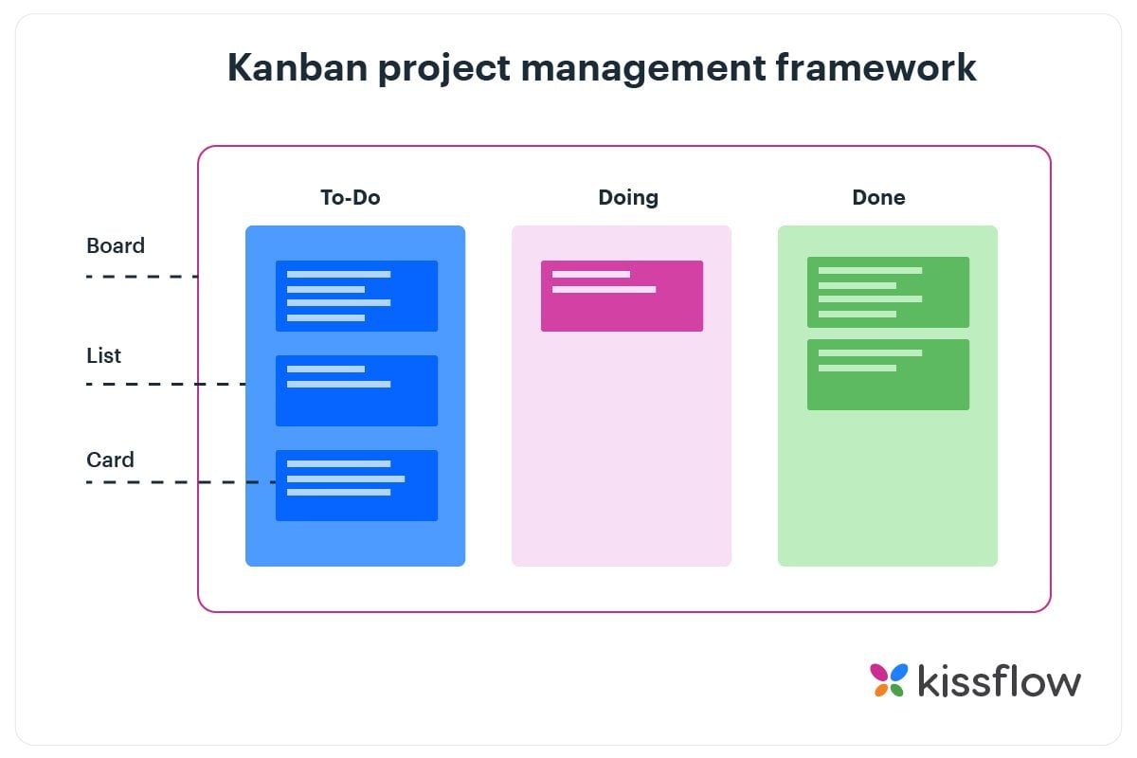
How does Kanban work?
Kanban method revolves around the kanban board. It is a tool that visualizes the entire project to track the flow of their project. Through this graphical approach of Kanban boards, a new member or an external entity can understand what’s happening right now, tasks completed and future tasks.
Kanban board indicates:
the current tasks that are being performed
the tasks to do in the future
the tasks that are completed

Slide 6
How does Kanban work?
The divided columns are interconnected and tasks are gradually pulled from the leftmost column (future tasks) to the rightmost column (completed tasks). Kanban system measures the work cycle being completed through the principle of Work in Progress (WIP). WIP has certain limits and a pre-defined specific status.
Limiting WIP in order to maintain consistent standards is one of the core principles that govern the Kanban methodology in Agile. It is extremely important for the team to complete the current tasks in the prescribed order.

Slide 7
Principles of Kanban
Start with what you do now
Agree to pursue incremental, evolutionary change
Respect the current process, roles, responsibilities, and titles
Encourage acts of leadership at all levels in your organization

Slide 8
Principles of Kanban (Continue)
Initiate with the existing workflow:
Kanban framework emphasizes on making small and gradual changes. Therefore, the team must start with the existing workflow and continuously improve the process.
2. Limit the existing tasks:
It is important for the team to realize its own limits and cap the WIP accordingly. Taking on more than you can handle will only waste time and negatively affect the project.

Slide 9
Principles of Kanban (Continue)
3. Respect existing roles and responsibilities:
An important reason for Kanban’s success is that it does not require organizations to completely overhaul the existing work culture. Many organizations resist modern methodologies because they don’t feel comfortable with change.
4. Encourage leadership at all levels:
Project management methodologies such as the traditional method require approval from the project manager for even the smallest tasks. Kanban gives the freedom of making decisions to the individual working on the task. This grooms future leaders who continuously learn from their mistakes and improve their work.

Slide 10
Core Practices of Kanban
Visualization of workflow:
The whole concept of Kanban revolves around proper visualization of the entire project. Kanban board software is used throughout the industry for this purpose. In the past, people used to get a whiteboard on wheels and use it with the help of different columns and Kanban cards.
2. Reduction of work in progress (WIP):
WIP in the case of Kanban is supposed to be according to the capability of the team. Usually, a cap is applied to WIP in order to ensure maximum efficiency. On the Kanban board, a limit is applied to the number of tasks that can be performed at once.

Slide 11
Core Practices of Kanban
3. Efficient workflow management:
Measuring lead time and cycle time where lead time, the complete time spent on completing a task is an important parameter that project teams must reduce as much as possible.
4. Explicit management policies:
It is important for the project team to know what they are trying to achieve. The reason behind is quite simple, when someone has a clear project goal in front of them, they’ll try harder to achieve it.
5. Take feedback:
At the end of the day, the most important entity for any business is the client and implementing an effective feedback system is extremely important.
On the Kanban boards, a column can be assigned for feedback from either an external evaluator or the customers themselves. In this way, the quality of the delivered work can be constantly maintained.

Slide 12
Benefits of Using Kanban Framework
Enhanced flexibility
Continuous improvement
Increased collaboration
Employee empowerment
Smoother workflow
Better inventory management
Improved quality control

